Slide 1
Image Encryption Using AES Algorithm
-By SAURABH KISHOR
19CS1100, CSE-2

Slide 2
AES (Advanced Encryption Standard):
A more secure encryption algorithm. which is a symmetric encryption algorithm.
The Advanced Encryption Standard (AES) algorithm is a symmetric block cipher that processes image which is of blocks size 128 bits using three different cipher key size of lengths 128,192 or 256 bits.
It uses AES Key Expansion in which the encryption process is a bit wise exclusive or operation of a set of image pixels along with the a 128 bit key which changes for every set of pixels.

Slide 3
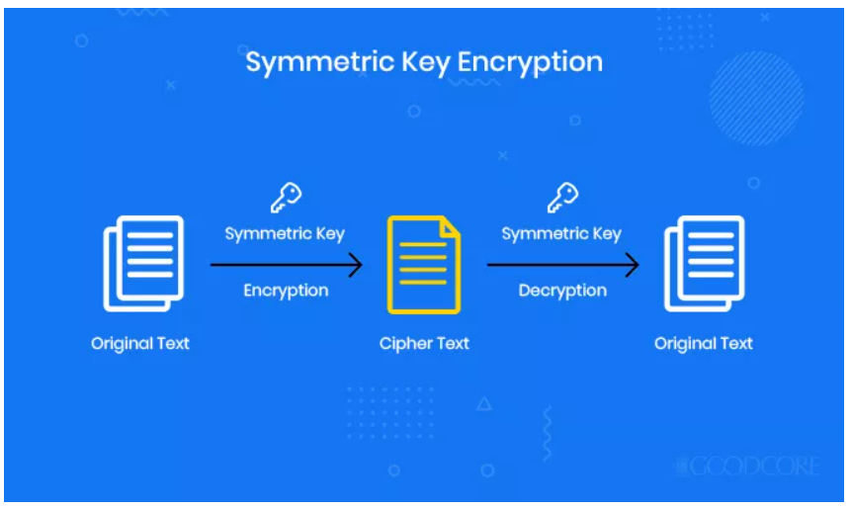
AES Image encryption: It is a technique that convert original image to another form that is difficult to understand. No one can access the content without knowing a decryption key. Image encryption has applications in corporate world, health care, military operations(screate missile dealing), and multimedia systems.

Slide 4
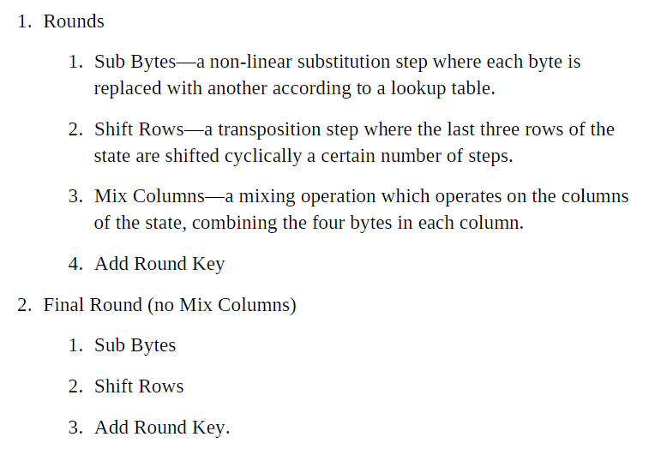
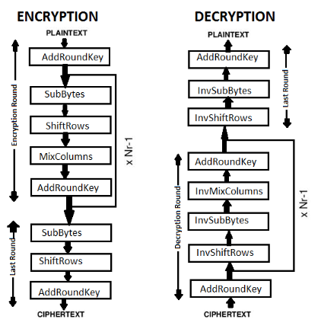

Slide 5
Advantages
The image can only be viewed by the receiver as the image is encrypted using AES and the key is only known to the sender and receiver.
Since the image is encrypted using AES, it is more secure than the DES and triple DES.
AES allows you to choose a 128-bit, 192-bit or 256-bit key, making it exponentially stronger than the 56-bit key of DES.
Since the key size is 192 bits, it makes the encryption and decryption more secure.

Slide 6
Disadvantages
The file size to be transmitted becomes large since it contains encrypted data.
Since the file size is huge it can be suspected to contain some critical information.

Slide 7
Demo:

Slide 8


